Slide 1
Pregelix: Think Like a Vertex, Scale Like Spandex
Yingyi Bu (UC Irvine)
Work with: Vinayak Borkar (UC Irvine) ,
Michael J. Carey (UC Irvine),
Tyson Condie (Microsoft & UCLA)

Slide 2
Outline
Introduction
Programming Model
Example Applications
System Internals
Experimental Results
Related Work
Conclusions

Slide 3
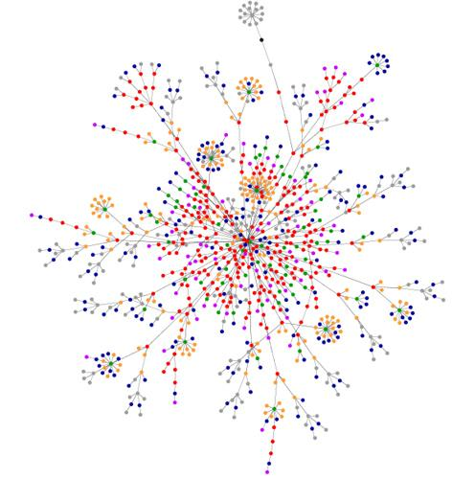
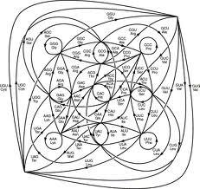
Introduction
Big Graphs are becoming common
web graph
social network
......

Slide 4
Introduction
How Big are Big Graphs?
Web: 8.53 Billion pages in 2012
Facebook active users: 1.01 Billion
de Bruijn graph: 3 Billion nodes
......
Weapons for mining Big Graphs
Hadoop/Hive (Facebook)
Pregel (Google)
Distributed GraphLab (CMU)

Slide 5
Programming Model (Pregel)
Think like a vertex
receive messages
update states
send messages

Slide 6
Programming Model (BSP)
Receive msgs
Update states
Send
msgs
Receive msgs
an iteration
Bulk synchronized
A synchronization barrier between iterations

Slide 7
Programming Model - API
Vertex (a super class for all applications)
public abstract class Vertex<I extends WritableComparable, V
extends Writable, E extends Writable, M extends Writable>
implements Writable{
/** * @param msgIterator an iterator of incoming messages */ public abstract void compute(Iterator<M> msgIterator);
.......
}
Helper methods
sendMsg(I vertexId, M msg)
voteToHalt()

Slide 8
Programming Model - Optional APIs
Combiner
Combine messages
Reduce network traffic
Global Aggregator
Aggregate statistics over all vertices
Done for each iteration
Early Termination (not in standard Pregel)
Force the job to terminate

Slide 9
Example Applications
PageRank
ConnectedComponents
Shortest Paths
Reachability query
Start the Demo!

Slide 10
System Internals
Pregel
GraphLab Giraph
......
Vertex/map/msg data structures
Task scheduling
Memory management
Message delivery
Network management
Our philosophy
Stop building one-off systems like Pregel, GraphLab, and Giraph, instead, building them on a data-flow engine!

Slide 11
System Internals
Pregelix
_{dest_id}UDAF(combine)
UDF (compute)
Pregel
Semantics
Barrier
Vertex/map/msg data structures
Msg
Vertice
Task scheduling
Task scheduling
Record/Index management
Memory management
Data exchanging
Buffer management
Message delivery
Connection management
Network management
A general purpose parallel dataflow engine

Slide 12
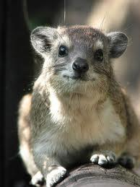
System Internals - Runtime
Runtime Choice?
Hyracks
Hadoop
The UCI Hyracks data-parallel execution engine
connection management
a set of operators: sorting, grouping, joining
task scheduling for jobs (a DAG of operators)
index support: B-tree, LSM-Btree, R-tree....

Slide 13
System Internals - Storage
Pregelix Job
DFS
DFS
Sorting
B-tree bulkload
DFS Read
Sorting
B-tree bulkload
DFS Read
B-tree bulkload
DFS Read
Sorting
B-tree index scan
DFS Write
B-tree index scan
DFS Write
B-tree index scan
DFS Write

Slide 14
System Internals - Outer Join Execution Plan
_{dest_id}UDAF(combine)
_{dest_id}UDAF(combine)
_{dest_id}UDAF(combine)
_{dest_id}UDAF(combine)
_{dest_id}UDAF(combine)
_{dest_id}UDAF(combine)
Barrier
UDF (compute)
Barrier
Barrier
UDF (compute)
UDF (compute)
Msg
Msg
Msg
Vertice B-tree
Vertice B-tree
Vertice B-tree

Slide 15
System Internals -Inner Join Execution Plan
_{dest_id}UDAF(combine)
_{dest_id}UDAF(combine)
_{dest_id}UDAF(combine)
_{dest_id}UDAF(combine)
_{dest_id}UDAF(combine)
_{dest_id}UDAF(combine)
Barrier
UDF (compute)
Barrier
Barrier
UDF (compute)
UDF (compute)
Live vertex IDs
Live vertex IDs
Live vertex IDs
Vertice B-tree
Vertice B-tree
Vertice B-tree
Msg
Msg
Msg

Slide 16
System Internals - Implementations
Right-outer join
Index merging join
Sender-side group-by
Sort + pre-clustered group-by
Data redistribution
Hash merging repartitioning connector
Sender-side materialization pipelining
Receiver-side group-by
Pre-clustered group-by
Inner join
Index probing join
Set Union
Index set union

Slide 17
System Internals
Spark, GraphLab, HaLoop all have caches for this kind of iterative jobs. What do you do for caching?
Iteration-aware (sticky) scheduling?
1 Loc: location constraints
Caching of invariant data?
B-tree buffer pool -- 1 Loc: never flush dirty pages
File system cache -- free

Slide 18
Experimental Results
Setup
Machines: Yahoo! Research cluster ~ 180 machines. Each has 8 cores, 12GB memory, 4 disk drives.
Dataset: Yahoo! webmap (1,413,511,393 vertice)

Slide 19
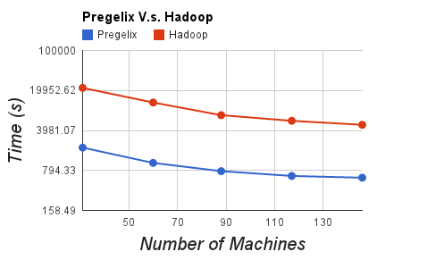
Experimental Results
10 iteration PageRank
1x webmap dataset

Slide 20
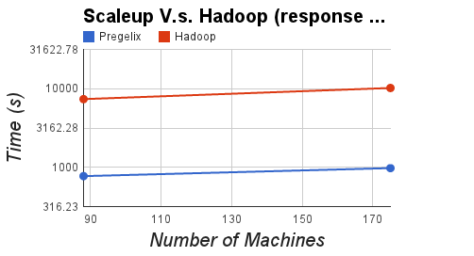
Experimental Results
10 iteration PageRank
1x webmap on 88 machines, 2x webmap on 175 machines

Slide 21
Related Work
Spark [NSDI 2012]
OutOfMemoryError
HaLoop [VLDB 2010]
Only 1.8X from Hadoop
Giraph
OutOfMemoryError
Mahout
OutOfMemoryError
Distributed GraphLab [VLDB 2012]
Haven't tried yet (just published in September...)

Slide 22
Conclusions
Vertex-oriented programming model is simple
Dataflow implementation is neat and efficient
We target Pregelix to be an open-sourced production system, rather than just a research prototype:
http://hyracks.org/projects/pregelix/

Slide 23
Q & A

